Slide 1
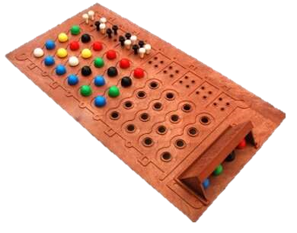


Development of MasterMind in Python
June 20th, 2020

Slide 2
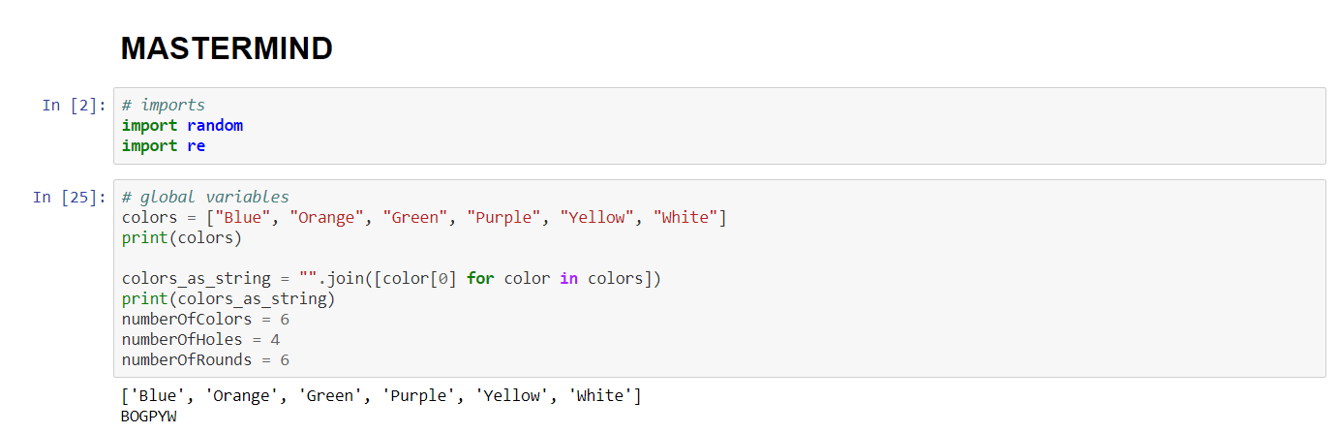
Import packages and define global variables

Slide 3
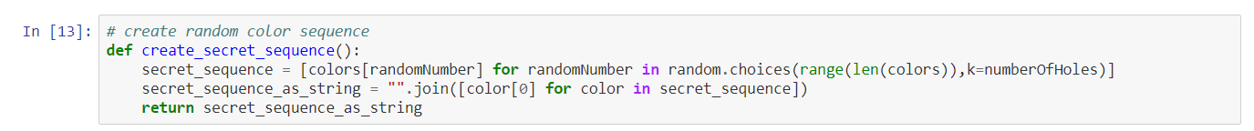
Create a random sequence of colors

Slide 4
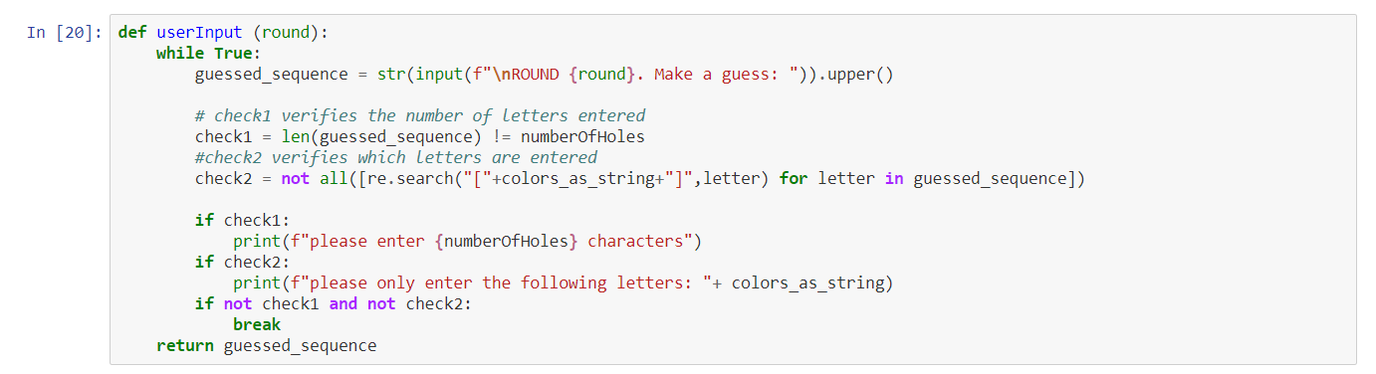
User guesses a sequence of colors

Slide 5
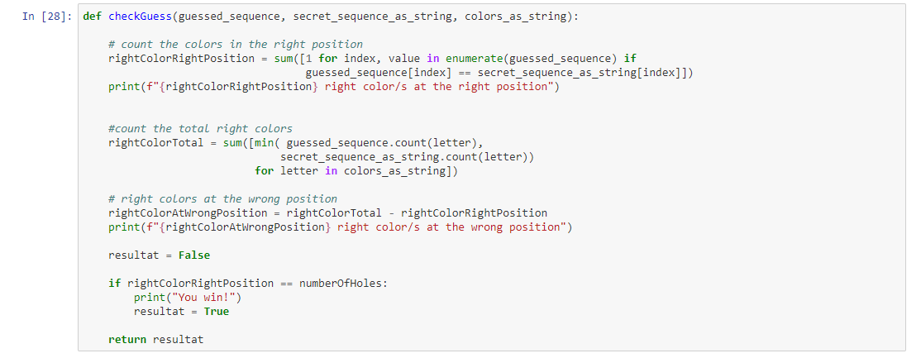
Verify the guess

Slide 6
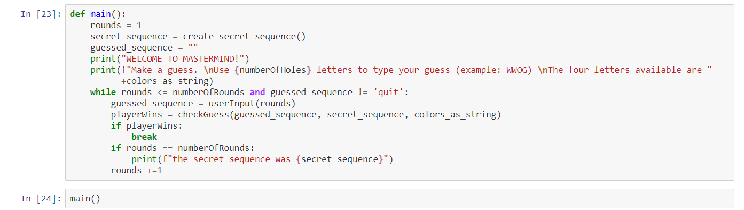
Main function

Slide 7
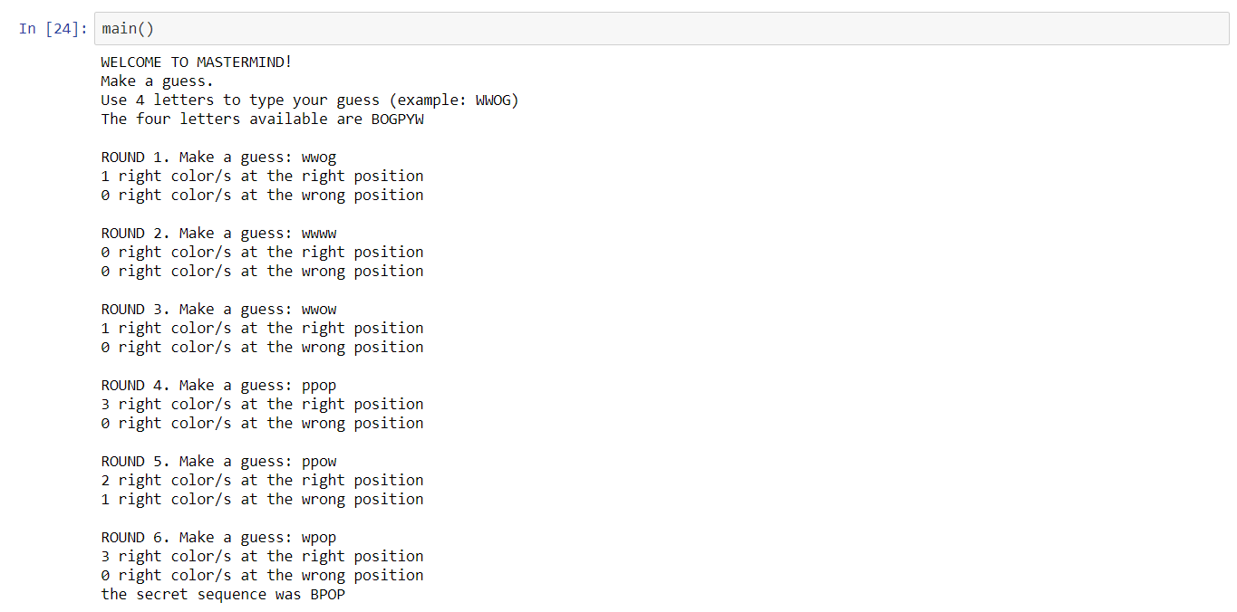
Run the game!

